Slide 1
Software Design
Hossam Adel

Slide 2




Who’s your instructor !
Hossam Adel (+7 year of Experience )
Graduated 2011 ( Benha University )
Master Degree in Embedded System
IST Industries (2 year) - CAI, EGY
Avelabs (2 year) – CAI, EGY
Thirdwayv (1 year) – CAI, EGY
Delphi Technologies (+1 year) – MI, USA
Freelancer Instructor Resala, AMIT, ITI, eCore and Sprints (+5 year)

Slide 3

Agenda
Introduction
Static Design
Dynamic Design
TMU (Timer Magnt Unit)
BCM (Basic Com Module)
References
Q&A
Conclusion

Slide 4
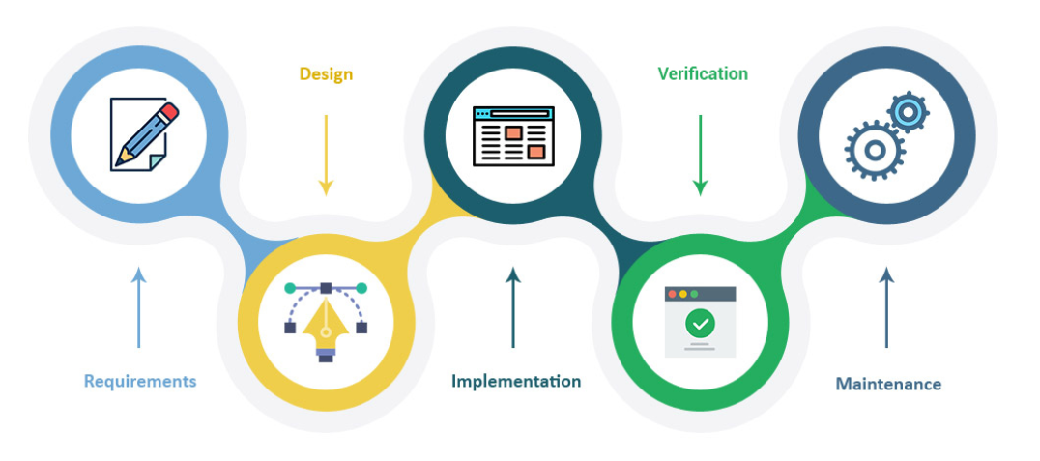
Introduction
SW Design
Software design is the process of envisioning and defining software solutions to one or more sets of problems. One of the main components of software design is the software requirements analysis (SRA).
Design Specs
Compatibility (backward-compatible)
Extendibility (add new code)
Modularity
Maintainability (easy for debug)
Reusability
Robustness (work hard)
Usability (user interface)
Scalability (increase input data)

Slide 5
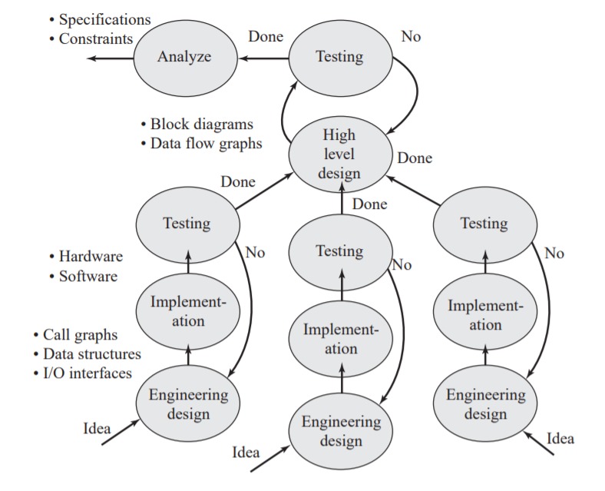
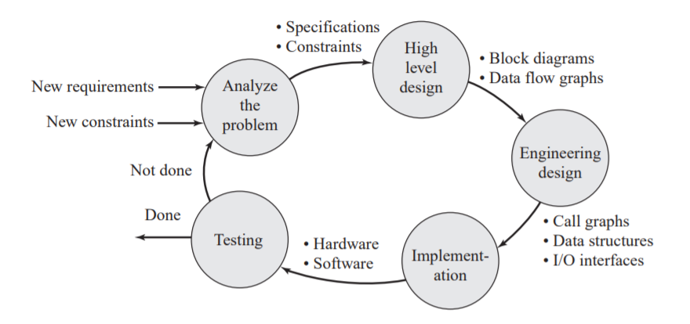
Software Design
Bottom Up Design Top-Down Design

Slide 6
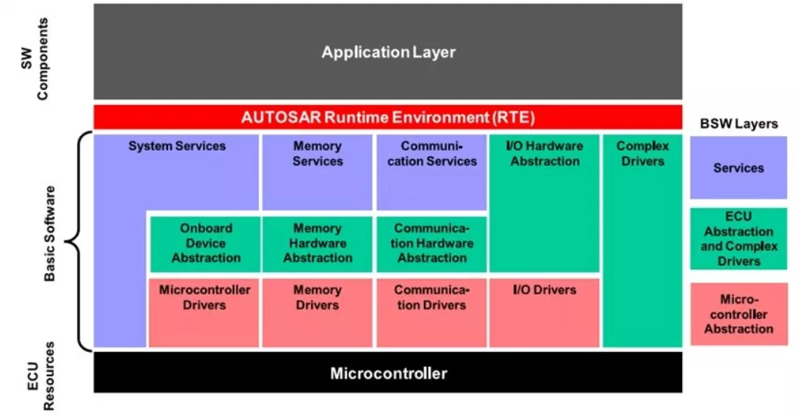
Static Design (software architecture)
Static Design have an answer for ..
What are the layers we have ?
Where’s the module allocate ?

Slide 7

Dynamic Design
Dynamic Design always answer how the modules talk with each other !

Slide 8
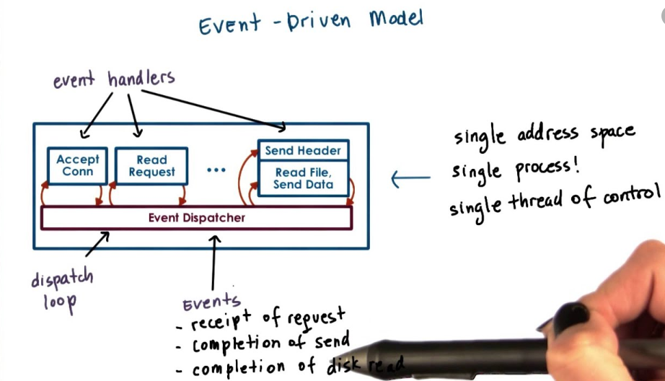
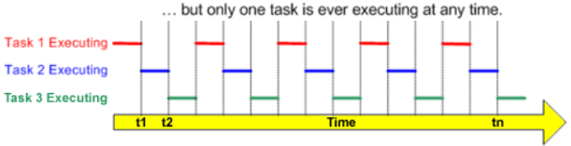
Dynamic Design
Super Loop Design
Event driven
Interrupt base Design
Event base Design
RTOS Design
Timing base Design

Slide 9
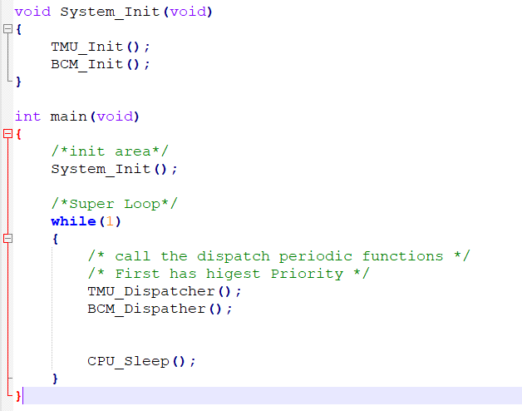
Super Loop Design

Slide 10
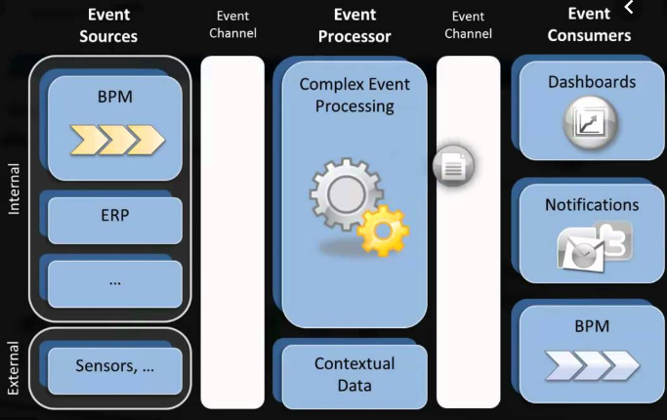
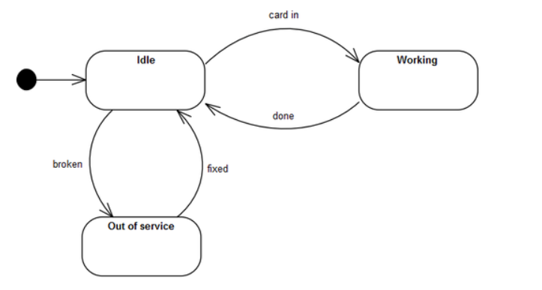
Event Driven Design (EDA)
Event Creator
Event Manager
Event Consumer
Sequence Diagram.
Finite state machine.

Slide 11

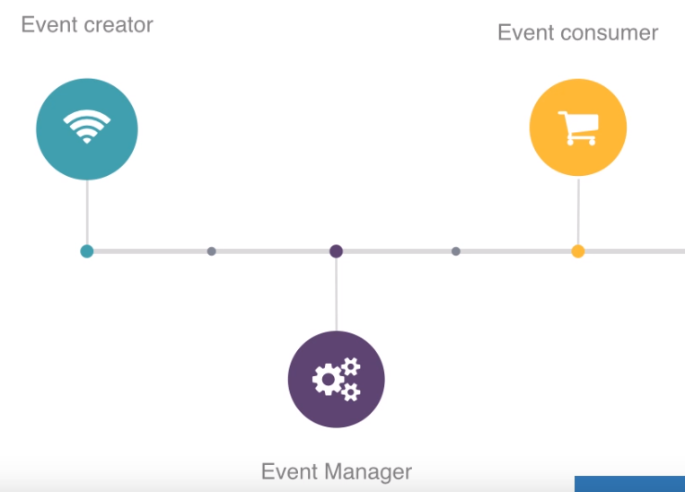
TMU (Timer Management Unit)
TMU_Init
TMU_Dispatcher
TMU_Start_Timer
TMU_Stop_Timer

Slide 12
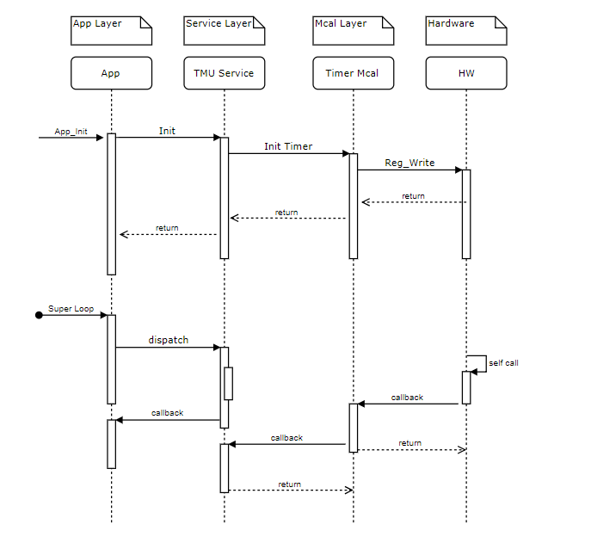
TMU (Timer Management Unit)

Slide 13

BCM (Basic Com Module )
How to send 1000 byte ?
Draw the Sequence Diagram !

Slide 14
BCM (Basic Com Module )
BCM_Init
BCM_Send
BCM_Receive
BCM_RxDispatcher
BCM_TxDispatcher
Packet [Command - Size – Data – CS ]

Slide 15
CPU Load
How to calculate the CPU utilization ?! In Super Loop Design Mechanism.
Assume we have two Dispatcher functions (TMU and BCM).

Slide 16
References
Use https://www.draw.io/ to draw the sequence Diagram
http://s1.nonlinear.ir/epublish/book/Embedded_Microcomputer_Systems_Real_Time_Interfacing_1111426252.pdf

Slide 17
THANK YOU
Hossam Adel

